Slide 1

RAJAR STUDIOS
Notes:
Rohan

Slide 2





Developers
Andrew Drummond Game Design & Sound Engineer
Rohan Kadkol Team Lead & Software Engineer
Jacob Dickson Game Design Map Design & Scripting
Ryan Courson Game Design & Software Engineer
Annabelle Kanchirathingal Web Developement & Game Design
Notes:
All of us

Slide 3
Each team is going to give a 8-minute presentation (strictly timed) to describe and demonstrate the finished game. Be sure to describe the following:
Briefly, introduce the concept of your game.
Demonstrate the final version of the game.
Demonstrate game mechanics and any emergent forms of play.
Highlight any capabilities that you think are impressive.

Slide 4

"When the humans go away, the rats come out to play." But what happens when there are two rat clans each wanting all the food in the house for themselves?
WAR!
Step into the shoes of your rat clan to destroy the enemy clan and claim the entire house and all it's food for your clan
Notes:
-> different food items around the map act as ammo and some map items can provide you with a nice advantage over the other clan

Slide 5
Demo
Talk about how it’s a FPS
HUD
Music
Soapy sponge Mechanic
Toaster Mechanic
Healing
Opponent
AI
Jumping off table
Moving around the room
Locating where the player is
Higher Vantage Points -> advantage over opponents
3 different rooms
Increased interest in the game for the player

Slide 6
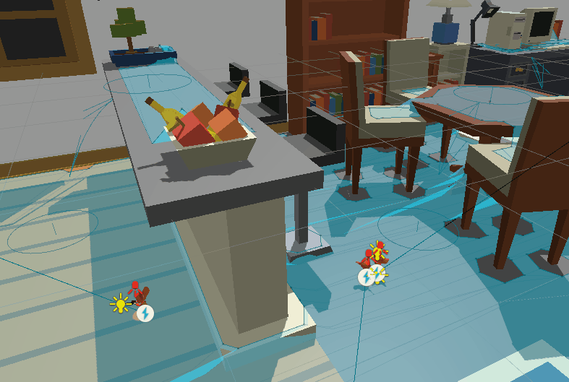

AI: Jumping Mechanism
Off-Mesh Link used to allow AI to reach higher surfaces.
Circles represent the endpoints while the arrows represent directionality of the link.

Slide 7
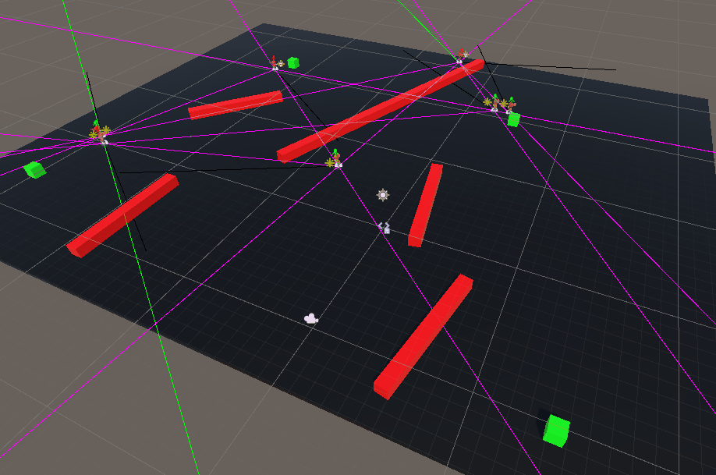
AI: Player Detection
Demonstration of AI-Player detection. Green lines appear only when AI is able to see enemies (red barriers obstruct view)

Slide 8
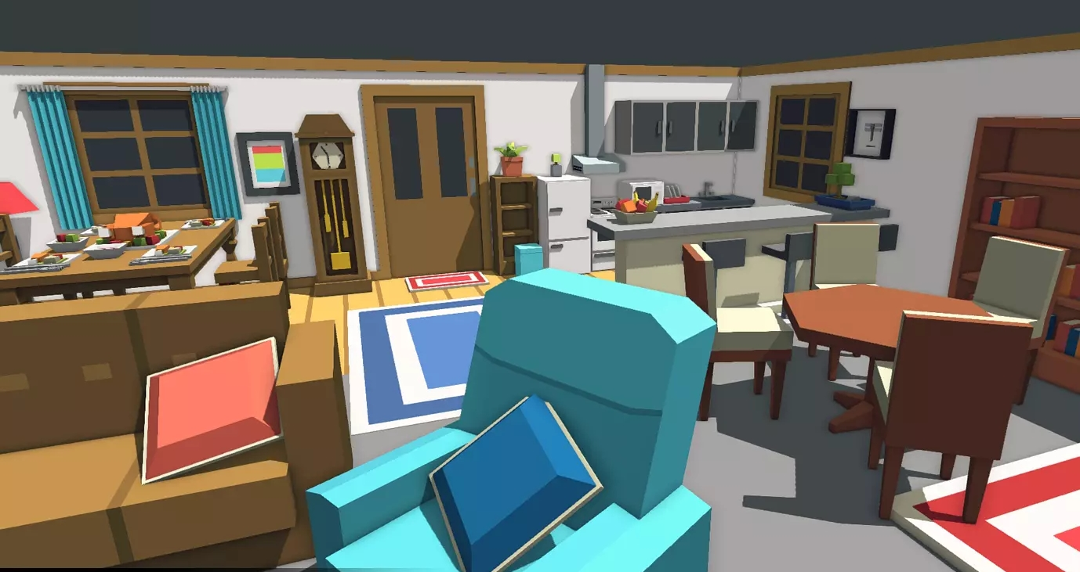
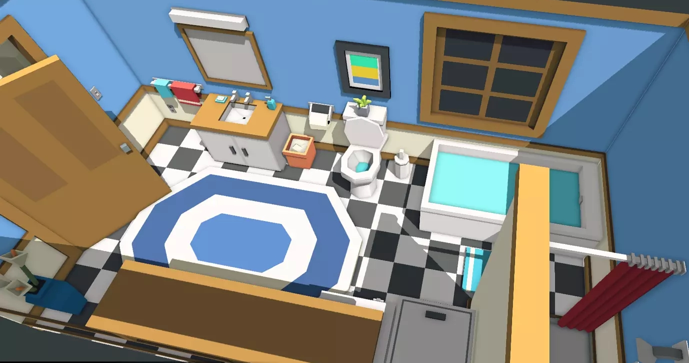
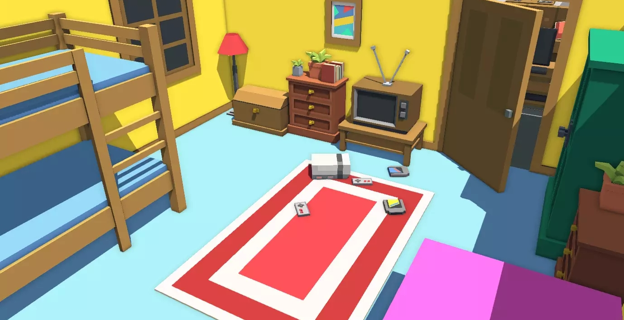
MAP
living room
bathroom
bedroom
Notes:
Each room has different objects which allow the player to get an advantage over their opponents

Slide 9
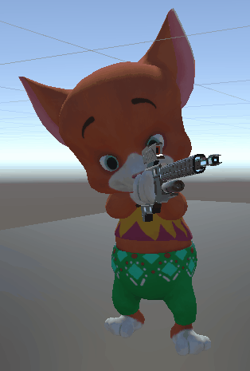
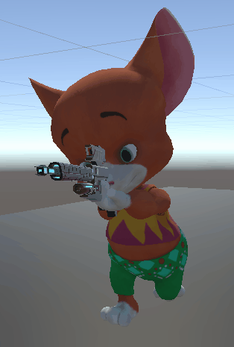
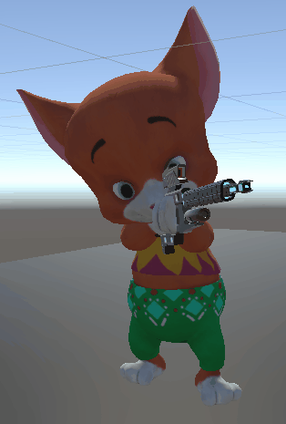
Player Movement
Idle
Running
Death
Notes:
Jake
- Our overall map design will stick to three connected rooms, for instance a...
- The pictures shown showcase rooms made with a asset pack on the unity store
- We will use these assets to build our own maps as opposed to simply taking these pre-built rooms

Slide 10

Music and Sound Design
All in-game and menu screen music was originally composed
Sound effects for Jumping and Player Damage were made through BFXR and SFXR
All other in-game sounds were found from the Unity Asset Store

Slide 11

HUD: Ammo Selector
Ammo count indicated by number in top right of inventory slot
Current ammo highlighted by colored outline

Slide 12
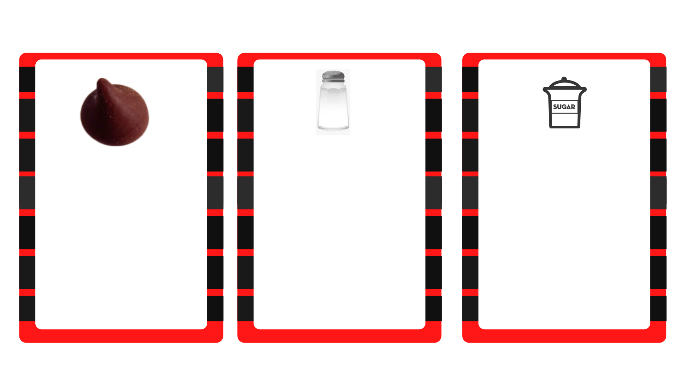
Chocolate Chip
Salt Crystal
Sugar Crystal
Highest Damage
Maximum of 10 chips
Limited
Lowest Damage
Maximum of 80 crystals
Smallest ammo type
Medium Damage
Maximum of 20 crystals

Slide 13
Future Plans
Notes:
Rohan

Slide 14
IMPLEMENT
Adding new maps
New Ammo types
Multiplayer

Slide 15

QUESTIONS?

